Slide 1

Social Networks
Chris Piech
CS106A, Stanford University

Slide 2
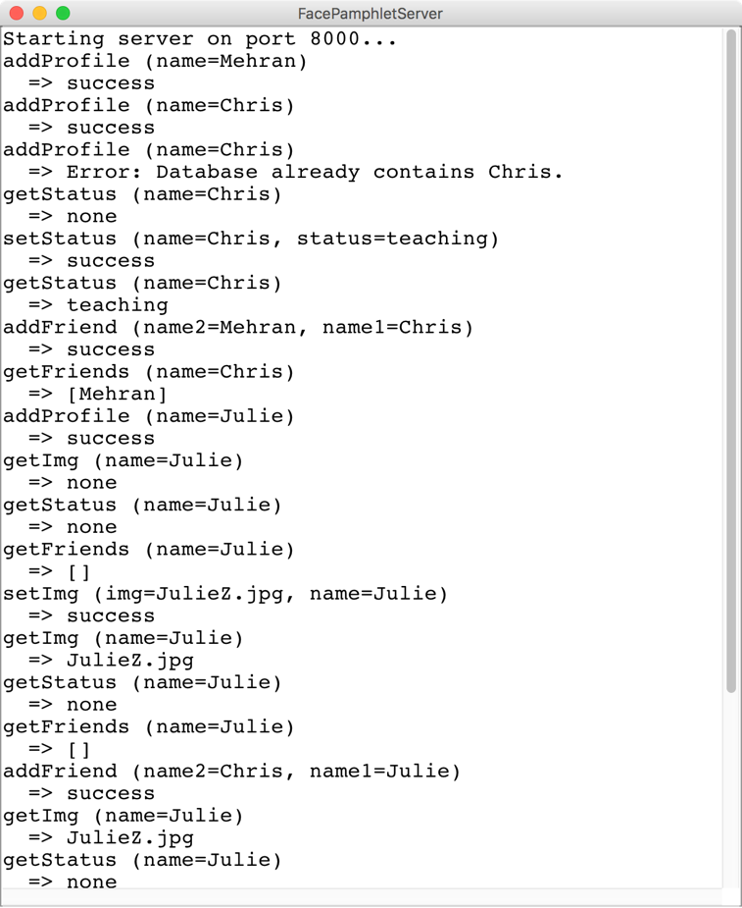
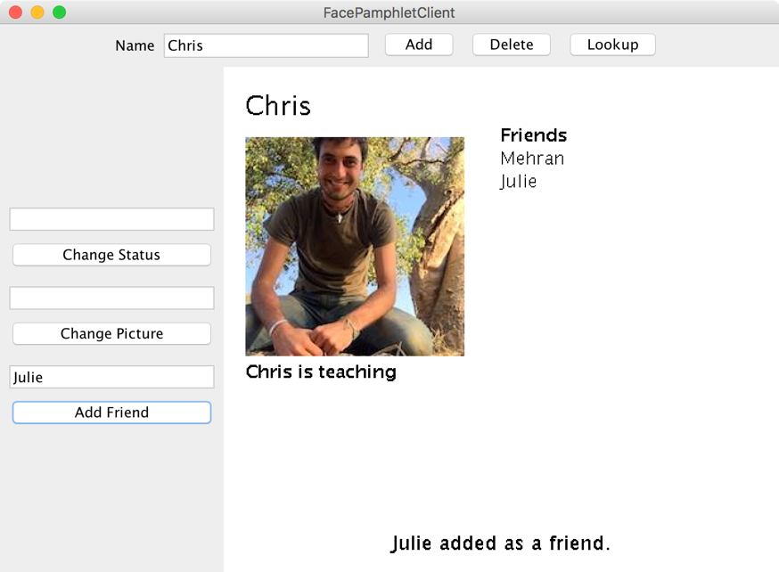
SteamTunnel
SteamTunnelServer
SteamTunnelClient

Slide 3
The Name

Slide 4
Question
How could users could join different SteamTunnels but still connect to one another.

Slide 5
Review

Slide 6
Background: The Internet
The internet is just many programs sending messages (as Strings)
Thanks Nick for the teaching YEAH

Slide 7
Background: The Internet
Facebook datacenter
Your computer (facebook.com)
The internet is just many programs sending messages (as Strings)
Thanks Nick for the teaching YEAH

Slide 8
Background: The Internet
Facebook datacenter
Your computer (facebook.com)
“Server”
“Client”
The internet is just many programs sending messages (as Strings)
Thanks Nick for the teaching YEAH

Slide 9
Background: The Internet
Facebook datacenter
Your computer (facebook.com)
Get status for “Nick Troccoli”
“Server”
“Client”
The internet is just many programs sending messages (as Strings)
Thanks Nick for the teaching YEAH

Slide 10
Background: The Internet
Facebook datacenter
“response”
Your computer (facebook.com)
“teaching YEAH”
Get status for “Nick Troccoli”
“Server”
“request”
“Client”
The internet is just many programs sending messages (as Strings)
Thanks Nick for the teaching YEAH

Slide 11
SteamTunnel
SteamTunnelServer
SteamTunnelClient
RESPONSE
REQUEST
“Server”
“Client”
Your task
Extra credit
Thanks Nick for the teaching YEAH
Notes:
Respond to all the requests the client could send! (Each internet program has its own “protocol” for what messages it sends)

Slide 12
Another way to get Server/Client
First, imagine a world before Server/Clients…
Interacts with user /
displays information
NameSurferDatabase
NameSurferEntry
NameSurfer
Stores information
* This blob represents one program on one machine

Slide 13
Another way to get Server/Client
First, imagine a world before Server/Clients…
Interacts with user /
displays information
SteamDatabase
Profile
SteamGraphics
Stores information
* This blob represents one program on one machine

Slide 14
Another way to get Server/Client
First, imagine a world before Server/Clients…
SteamDatabase
Profile
SteamGraphics
* This blob represents one program on one machine

Slide 15
Another way to get Server/Client
Now our application runs across two programs
Client
Server
RESPONSE
SteamGraphics
SteamDatabase
REQUEST
SteamProfile
* Each blob represents one program on one machine

Slide 16
Another way to get Server/Client
Which means many clients can connect to the data
Client
Server
RESPONSE
SteamGraphics
SteamDatabase
REQUEST
SteamProfile
RESPONSE
Client
SteamGraphics
REQUEST
* Each blob represents one program on one machine

Slide 17
The Internet
SteamTunnel datacenter
RESPONSE
REQUEST
REQUEST
Your mom’s computer
(linux shell)
RESPONSE
“Server”
Tate Ole Keko’s computer (facebook.com)
Chris’ phone (facebook app)
“Client”
“Client”
“Client”

Slide 18
Most of the Internet
Aka “the frontend”
Aka “the backend”
Server / Clients
Aka “the cloud”
Aka “the GUI”

Slide 19
Servers on one slide
public String requestMade(Request request) {
// server code goes here
}
1
2
// make a Server object
private SimpleServer server
= new SimpleServer(this, 8000);
3
public void run(){
// start the server
server.start();
}

Slide 20
Servers on one slide
public String requestMade(Request request) {
// server code goes here
}
1
2
// make a Server object
private SimpleServer server
= new SimpleServer(this, 8000);
3
public void run(){
// start the server
server.start();
}

Slide 21
What is a Request?
/* Request has a command */
String command;
/* Request has parameters */
HashMap<String,String> params;
Request request
// methods that the server calls on requests
request.getCommand();
request.getParam(key); //returns associated value

Slide 22
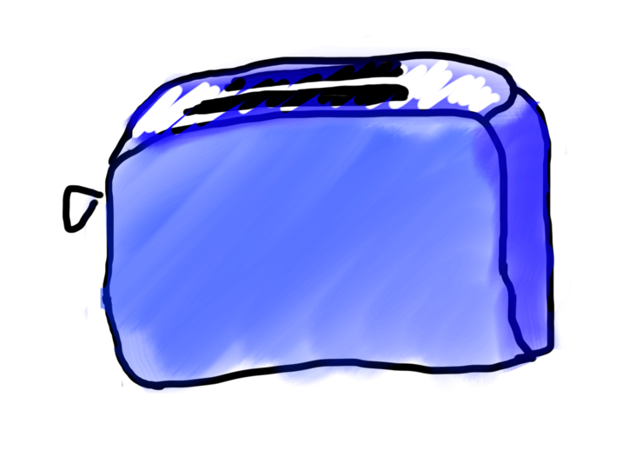
Requests are like Remote Method Calls
Server has a bunch of discrete things it can do
Server
addUser
getStatus

Slide 23
Requests are like Remote Method Calls
Server
addUser
getStatus

Slide 24
Requests are like Remote Method Calls
request.getCommand();
=> ”addUser”
Server
addUser
getStatus

Slide 25
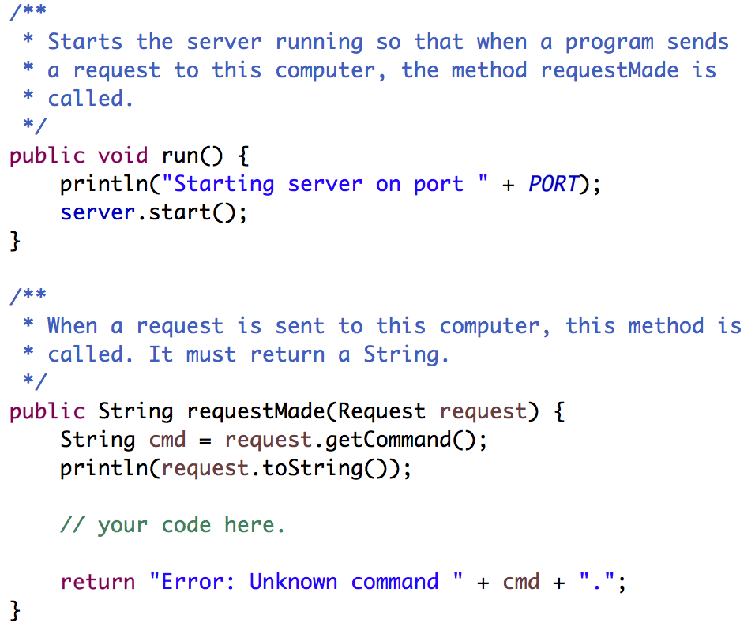
Your Server Code
Respond to requests here. The String you return will be sent as the response.
Notes:
What is a request? A way to structure messages so they’re consistent and easy to understand.

Slide 26
Where we left off...

Slide 27
There are two types of internet programs. Servers and Clients

Slide 28
Now, the client

Slide 29
A Clients’s Purpose
1. Interact with the user
2. Get data from its server
3. Save data to its server

Slide 30
Clients on one slide
try {
// 1. construct a new request
Request example = new Request("getStatus");
// 2. add parameters to the request
example.addParam("name", "chris");
// 3. send the request to a computer on the internet
String result = SimpleClient.makeRequest(HOST, example);
} catch(IOException e) {
// The internet is a fast and wild world my friend
}

Slide 31
Clients on one slide
try {
// 1. construct a new request
Request example = new Request("getStatus");
// 2. add parameters to the request
example.addParam("name", "chris");
// 3. send the request to a computer on the internet
String result = SimpleClient.makeRequest(HOST, example);
} catch(IOException e) {
// The internet is a fast and wild world my friend
}

Slide 32
Clients on one slide
try {
// 1. construct a new request
Request example = new Request("getStatus");
// 2. add parameters to the request
example.addParam("name", "chris");
// 3. send the request to a computer on the internet
String result = SimpleClient.makeRequest(HOST, example);
} catch(IOException e) {
// The internet is a fast and wild world my friend
}

Slide 33
Clients on one slide
try {
// 1. construct a new request
Request example = new Request("getStatus");
// 2. add parameters to the request
example.addParam("name", "chris");
// 3. send the request to a computer on the internet
String result = SimpleClient.makeRequest(HOST, example);
} catch(IOException e) {
// The internet is a fast and wild world my friend
}

Slide 34
Clients on one slide
try {
// 1. construct a new request
Request example = new Request("getStatus");
// 2. add parameters to the request
example.addParam("name", "chris");
// 3. send the request to a computer on the internet
String result = SimpleClient.makeRequest(HOST, example);
} catch(IOException e) {
// The internet is a fast and wild world my friend
}

Slide 35
Clients on one slide
try {
// 1. construct a new request
Request example = new Request("getStatus");
// 2. add parameters to the request
example.addParam("name", "chris");
// 3. send the request to a computer on the internet
String result = SimpleClient.makeRequest(HOST, example);
} catch(IOException e) {
// The internet is a fast and wild world my friend
}

Slide 36
Clients on one slide
try {
// 1. construct a new request
Request example = new Request("getStatus");
// 2. add parameters to the request
example.addParam("name", "chris");
// 3. send the request to a computer on the internet
String result = SimpleClient.makeRequest(HOST, example);
} catch(IOException e) {
// The internet is a fast and wild world my friend
}

Slide 37
Clients on one slide
try {
// 1. construct a new request
Request example = new Request("getStatus");
// 2. add parameters to the request
example.addParam("name", "chris");
// 3. send the request to a computer on the internet
String result = SimpleClient.makeRequest(HOST, example);
} catch(IOException e) {
// The internet is a fast and wild world my friend
}

Slide 38
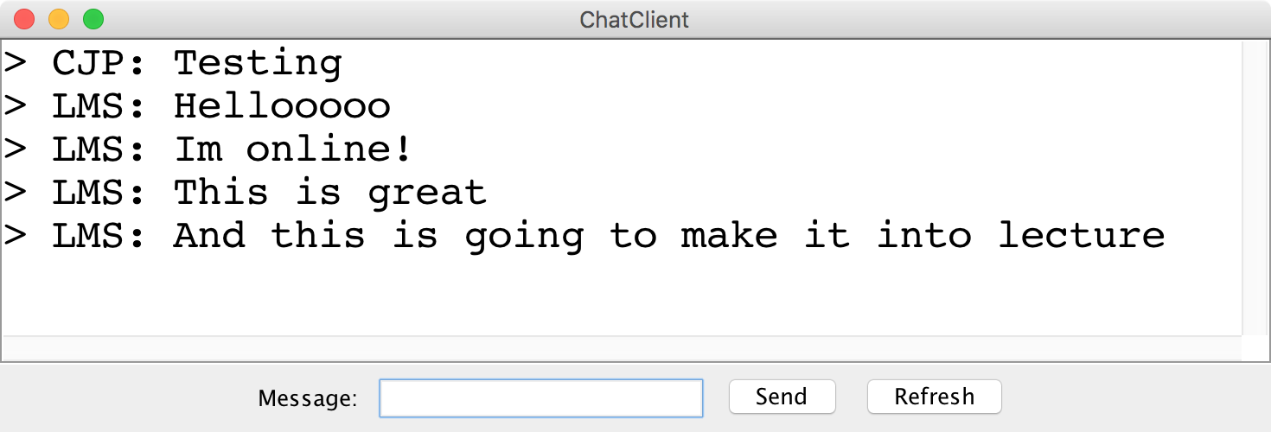
Chat Server and Client

Slide 39
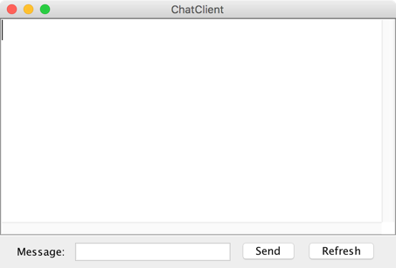
history = [
]
addMsg
msg = C: Hello world
Chat Client
Chat Client
Send
Hello world
Send

Slide 40
history = [
C: Hello world
]
getMsgs
index = 0
Chat Client
Chat Client
Send
Send

Slide 41
Chat Server
addMsg
msg = text
Chat Server
getMsgs
index = startIndex

Slide 42
There are two types of internet programs. Servers and Clients

Slide 43
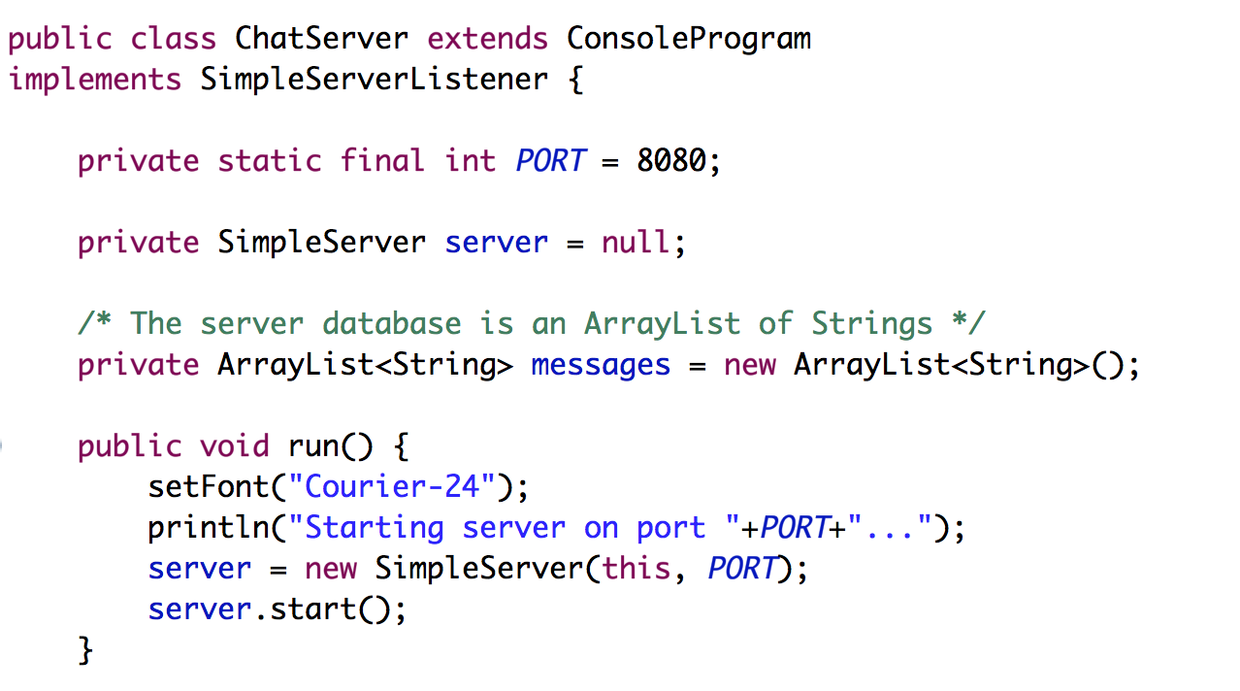
Chat Server
… that’s not all

Slide 44
Chat Server
… that’s not all

Slide 45
Chat Server
… that’s not all

Slide 46
Chat Server
… that’s not all

Slide 47
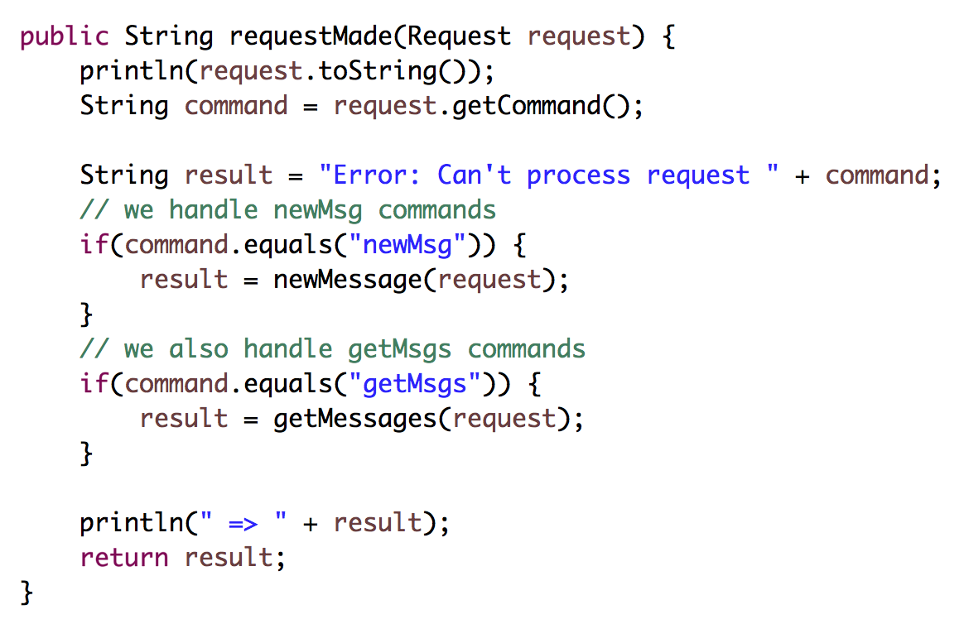
Chat Server (continued)

Slide 48
Chat Server (continued)

Slide 49
Chat Server (continued)

Slide 50
Chat Server (continued)

Slide 52
FAQ

Slide 53
Question: This is cool Chris.
But didn’t you just really
dumb down servers?

Slide 54
Answer: No

Slide 55
Question: Why isn’t this in a browser?

Slide 56
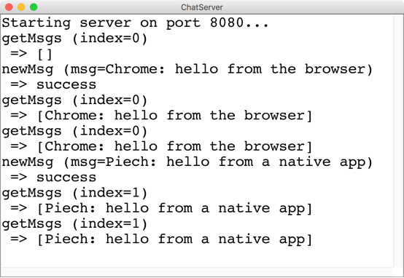
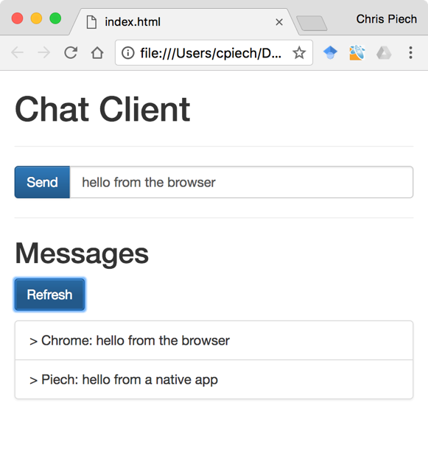
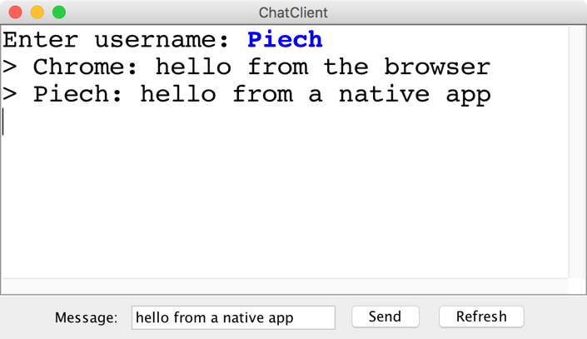
“Native” vs “Browser”

Slide 57
Question: Localhost forever?

Slide 58
Use ngrok to get a url

Slide 60
Any security holes?

Slide 61
Want to learn more?
CS144 Computer Networking
Or CS193P
Or CS193A
Or CS108

Slide 62
Social Networks

Slide 63

Who Do You Love
Who do you love?
And how does Facebook know?

Slide 64
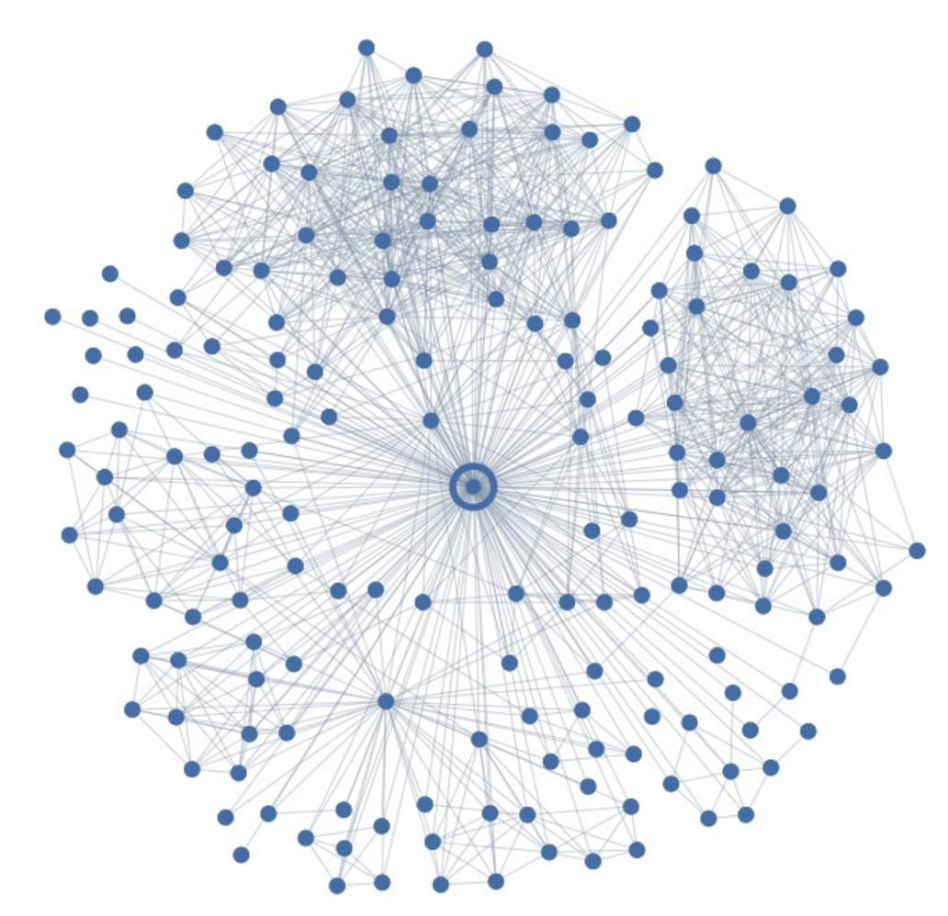
Ego Graph
Your local social network

Slide 65
Maybe I Love These People?
You have some “groups”

Slide 66
But I Actually Love This Person
But here is the love of your life
Your significant other
George

Slide 67
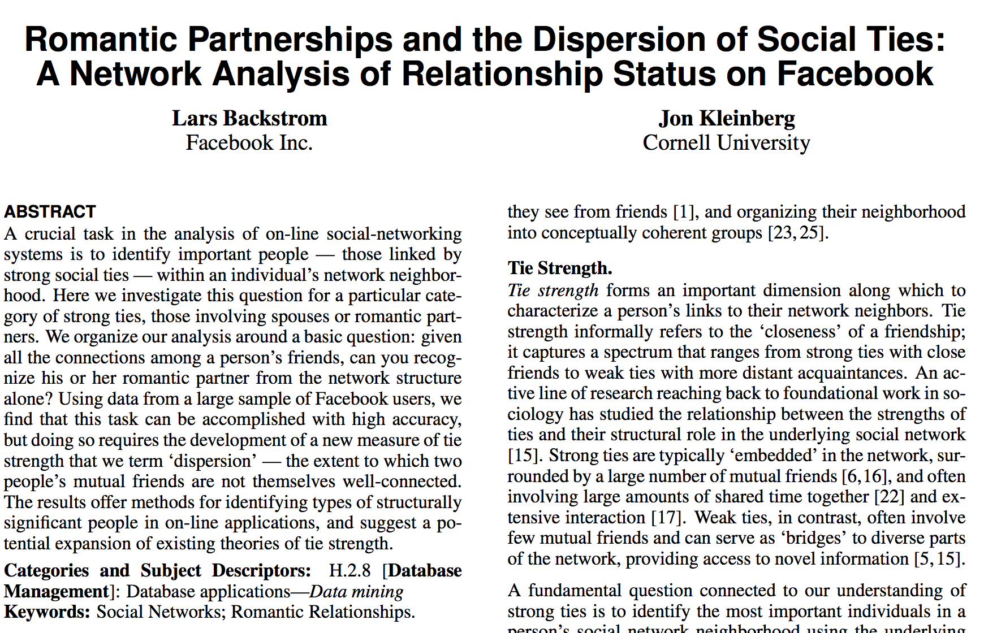
Romance and Dispersion
Romance and Social Networks
October 2013
http://arxiv.org/pdf/1310.6753v1.pdf

Slide 68
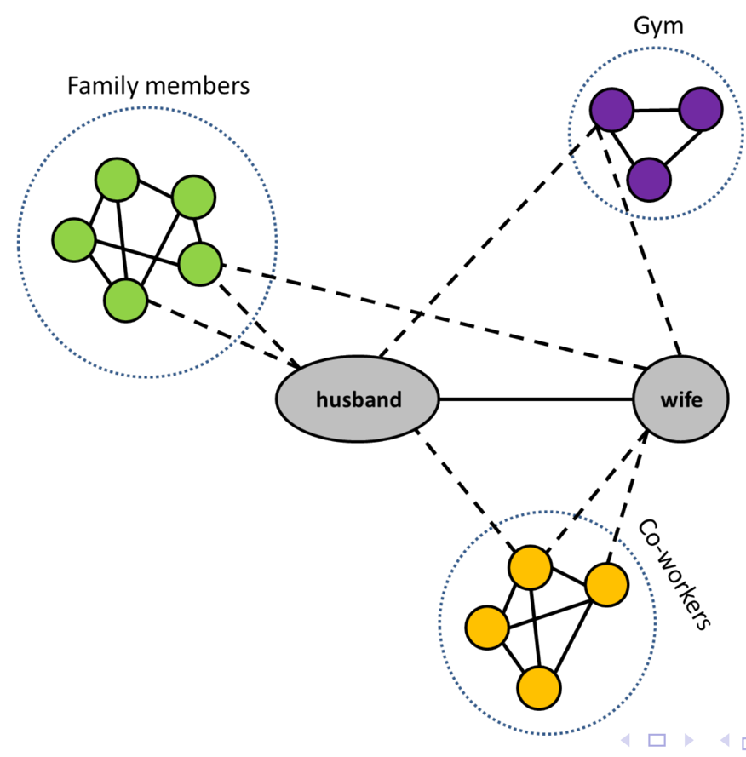
Dispersion Insight
Romance and Social Networks
Dispersion: The extent to which two people’s
mutual friends are not directly connected

Slide 69
Dispersion Insight
Mining Massive Datasets
CS246: Mining Massive Datasets
Jure Leskovec
Or CS106B or CS103 or CS109
Dispersion: The extent to which two people’s
mutual friends are not directly connected

Slide 70
filter bubble
fake news
hate speech
privacy
monopoly
Omer Reingold: Fairness Through Computationally-Bounded Awareness

Slide 71
Question
How could users could join different SteamTunnels but still connect to one another.

Slide 72
Federated Internet Applications
Professor Monica Lam

Slide 73
The end.

